Slide 1
Cloud Resource Virtualization
Session 05
Course : COSC6100001 - Cloud Infrastructure
D6825 - Samuel Philip

Slide 2
Learning Objectives
LO1: (C4) Analysis : identify problems that can be solved using cloud global infrastructure
LO2: (C2) Comprehension : group Classify real-worlds problems in accordance with cloud computing infrastructure
LO3: (C4) Analysis : analyze identifying problems and choose proper Cloud Services and Cloud Infrastructure

Slide 3
Outline
Virtualization Principles
Performance and Security Isolation
Nested Virtualization
Open-source Software Platforms for Private Clouds
The Implementation of Virtualization

Slide 4
Virtualization principles

Slide 5
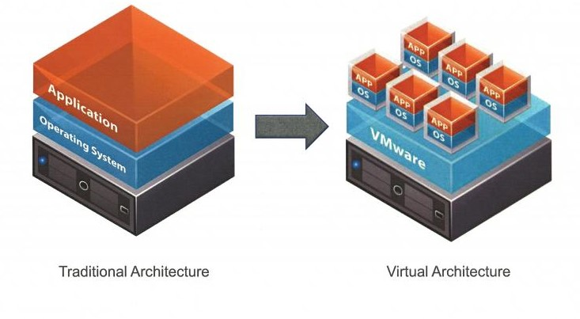
Virtualization principles
Virtualization simulates the interface with a physical object by any one of four means :
Multiplexing: create multiple virtual objects from one instance of a physical object. For example, a processor is multiplexed among a number of processes or threads.
Aggregation: Create one virtual object from multiple physical objects. For example, a number of physical disks are aggregated into a RAID disk.

Slide 6
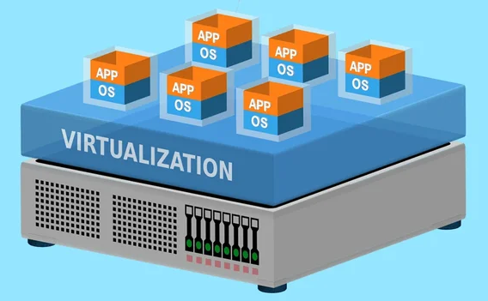
Virtualization principles
Virtualization simulates the interface with a physical object by any one of four means :
Emulation: Construct a virtual object from a different type of a physical object. For example, a physical disk emulates a Random Access Memory.
Multiplexing and emulation. Examples are: virtual memory with paging multiplexes main memory and secondary storage; a virtual address emulates a real address; the TCP protocol emulates a reliable bit pipe and multiplexes a physical communication channel and a processor.

Slide 7
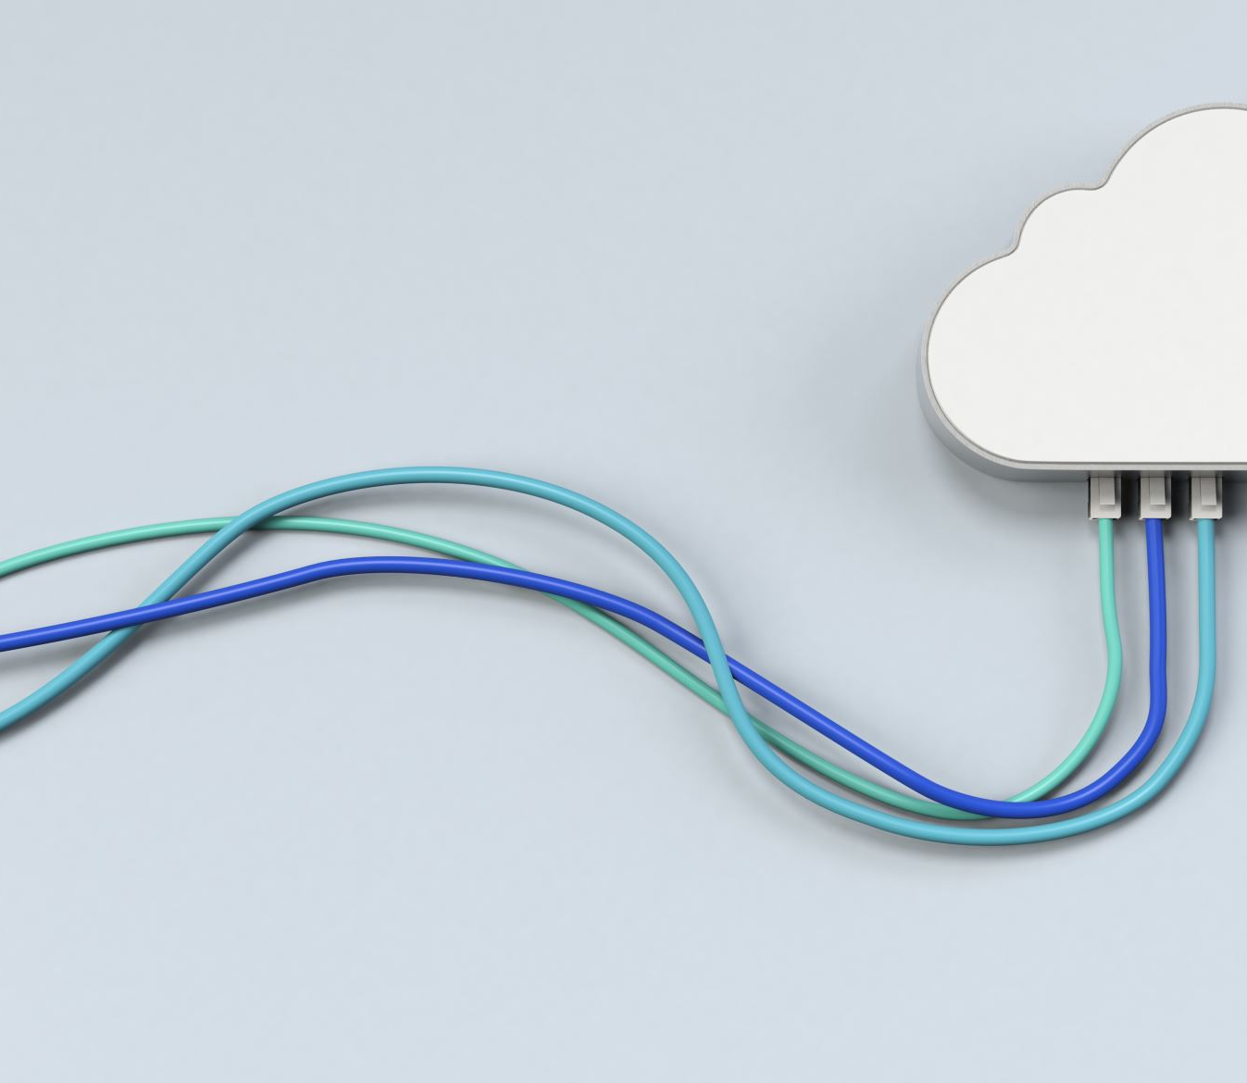
Virtualization principles
advantages
Virtualization is a critical aspect of cloud computing, equally important for the providers and the consumers of cloud services, and plays an important role for:
system security because it enables isolation of services running on the same hardware;
performance and reliability because it enables applications to migrate from one platform to another;
the development and management of services offered by a provider; and
performance isolation.

Slide 8
Virtualization principles
Side effects
Slicing up hardware isn’t a free real estate*
Performance penalty : All privileged operations of a VM must be trapped and validated by the hypervisor, which ultimately controls the system behavior. The increased overhead introduced by the hypervisor has a negative impact on the performance.
Hardware costs : The cost of a system running multiple VMs is higher than the cost of a system running a traditional OS.

Slide 9
Virtual Machines
A VM is an isolated environment with access to a subset of the physical resources of a computer system.
Each VM appears to be running on the bare hardware, giving the appearance of multiple instances of the same computer, though all are supported by a single physical system.
There are two types of VMs, process and system.

Slide 10
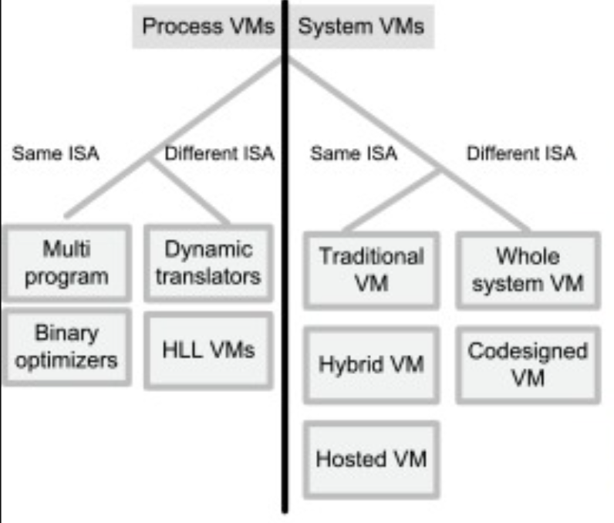
Virtual machine
Process vm
A process VM is a virtual platform created for an individual process
It will be destroyed once the process terminates. Virtually all operating systems provide a process VM for each one of the applications running, but the more interesting process VMs are those that support binaries compiled on a different instruction set.

Slide 11
Virtual machine
System vm
A system VM supports an OS together with many user processes
When the VM runs under the control of a normal OS and provides a platform-independent host for a single application, we have an application VM, e.g., Java Virtual Machine (JVM).
A system VM provides a complete system: Each VM can run its own OS, which in turn can run multiple applications. Systems such as Linux Vserver http://linux-vserver.org, OpenVZ (Open VirtualiZation), FreeBSD Jails, and Solaris Zones based on Linux, FreeBSD, and Solaris, respectively, implement OS-level virtualization technologies.

Slide 12
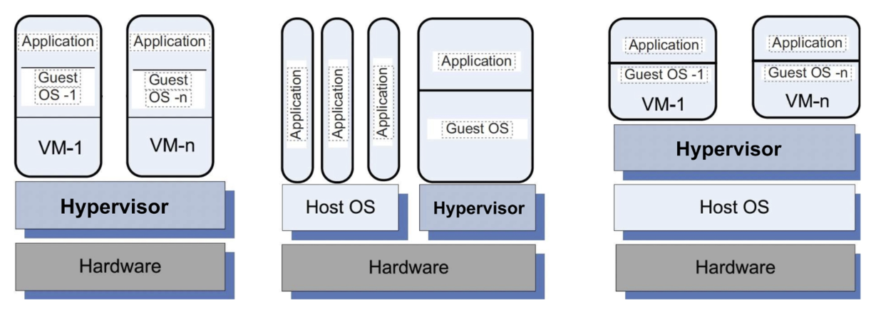
Virtual machine
architectures
Hypervisor’s Role in VM Architectures
Notes:
Hypervisor's role in traditional, hybrid, and hosted VM architectures.
(Left) Traditional VMs; hypervisor supports multiple VMs and runs directly on the hardware.
(Center) Hybrid VM; hypervisor shares the hardware with a host OS and supports multiple VMs.
(Right) Hosted VM; hypervisor runs under a host OS.

Slide 13
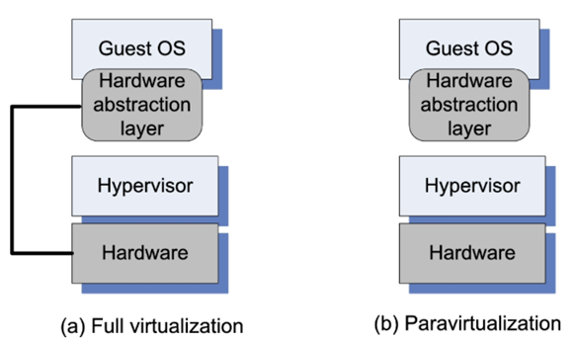
Virtual machine
Full and paravirtualization
Full virtualization requires the hardware abstraction layer
of the guest OS to have some knowledge about the processor architecture. The guest OS runs unchanged, thus, this virtualization mode is more efficient than paravirtualization.

Slide 14
Virtual machine
Full and paravirtualization
paravirtualization when each VM runs on a slightly modified copy of the actual hardware.
Paravirtualization is often adopted for several reasons:
(1) some aspects of the hardware cannot be virtualized;
(2) has better performance; and
(3) presents a simpler interface.

Slide 15
Nested virtualization

Slide 16
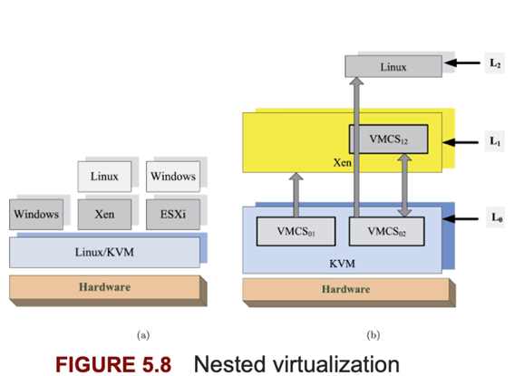
Nested virtualizatoin
Nested virtualization describes a system organization when a guest hypervisor runs inside a VM, which is itself running under a host hypervisor.
KVM allows three VM to run concurrently. Two VMs run hypervisors Xen and ESXi, and the third runs Windows. A VM runs Linux under Xen, and another VM runs Windows under ESXi.
Intel-supported nested virtualization. KVM runs at level L0, Xen runs at level L1, and KVM uses VMCS01 for the VM running Xen.

Slide 17
Nested virtualizatoin
Cases to use it
Nested virtualization describes a system organization when a guest hypervisor runs inside a VM, which is itself running under a host hypervisor.
KVM allows three VM to run concurrently. Two VMs run hypervisors Xen and ESXi, and the third runs Windows. A VM runs Linux under Xen, and another VM runs Windows under ESXi.
Intel-supported nested virtualization. KVM runs at level L0, Xen runs at level L1, and KVM uses VMCS01 for the VM running Xen.
Notes:
Nested virtualization is limited by the hardware support. When the hardware supports multilevel nested virtualization, each hypervisor handles all traps caused by sensitive instructions of guest hypervisors running directly above of it.
Multilevel nested virtualization is supported by the IBM System Z architecture. Intel and AMD processors support only single-level nested virtualization.

Slide 18
Open-source Software Platforms for Private Clouds

Slide 19
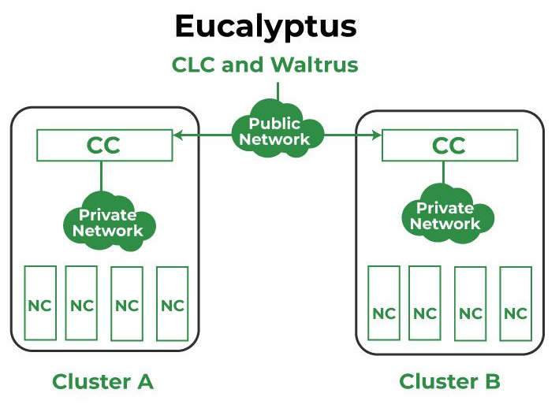
Eucalyptus
Eucalyptus (http://www.eucalyptus.com/) can be regarded as an open-source counterpart of Amazon's EC2
The system supports several operating systems, including: CentOS 5 and 6, RHEL 5 and 6, Ubuntu 10.04 LTS, and 12.04 LTS
inux-based open-source software architecture for cloud computing and also a storage platform that implements Infrastructure a Service (IaaS). It provides quick and efficient computing services. Eucalyptus was designed to provide services compatible with Amazon's EC2 cloud and Simple Storage Service(S3)..

Slide 20
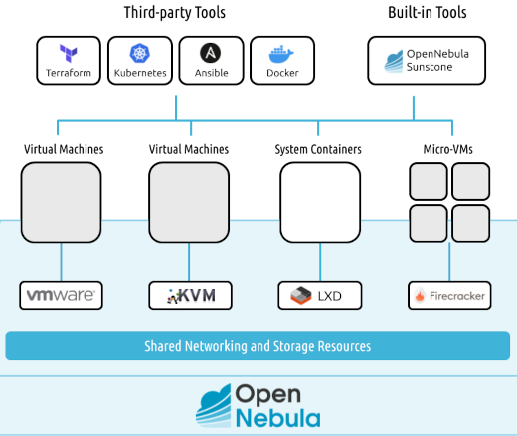
Open-nebula
Open-Nebula (http://www.opennebula.org/) is a private cloud with users actually logging into the head node to access cloud functions. The system is centralized, and its default configuration uses the NFS filesystem.
is a private cloud with users actually logging into the head node to access cloud functions. The system is centralized, and its default configuration uses the NFS filesystem.
OpenNebula platform delivers end-to-end coverage, vendor neutrality, and comprehensive support across cloud and virtualization management, hypervisor operations, and Kubernetes orchestration
Notes:
The euca2ools front-end is used to request a VM.
The VM disk image is transferred to a compute node.
The disk image is modified for use by the hypervisor on the compute node.
The compute node sets up network bridging to provide a virtual NIC with a virtual MAC address.
The head node the DHCP is set up with the MAC/IP pair.
The hypervisor activates the VM.(
The user can now ssh directly into the VM.

Slide 21
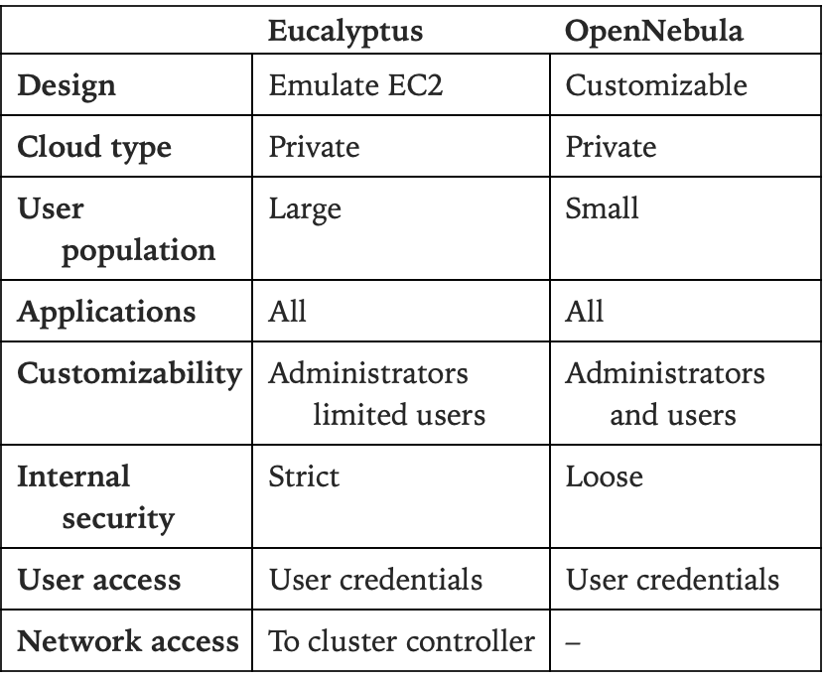
Open-nebula vs eucalyptus
The system is best suited for an operation involving a small-to-medium sized group of trusted and knowledgeable users who are able to configure this versatile system based on their needs.
Eucalyptus is best suited for a large corporation with its own private cloud because it ensures a degree of protection from user malice and mistakes;
OpenNebula is best suited for a testing environment with a few servers.

Slide 22
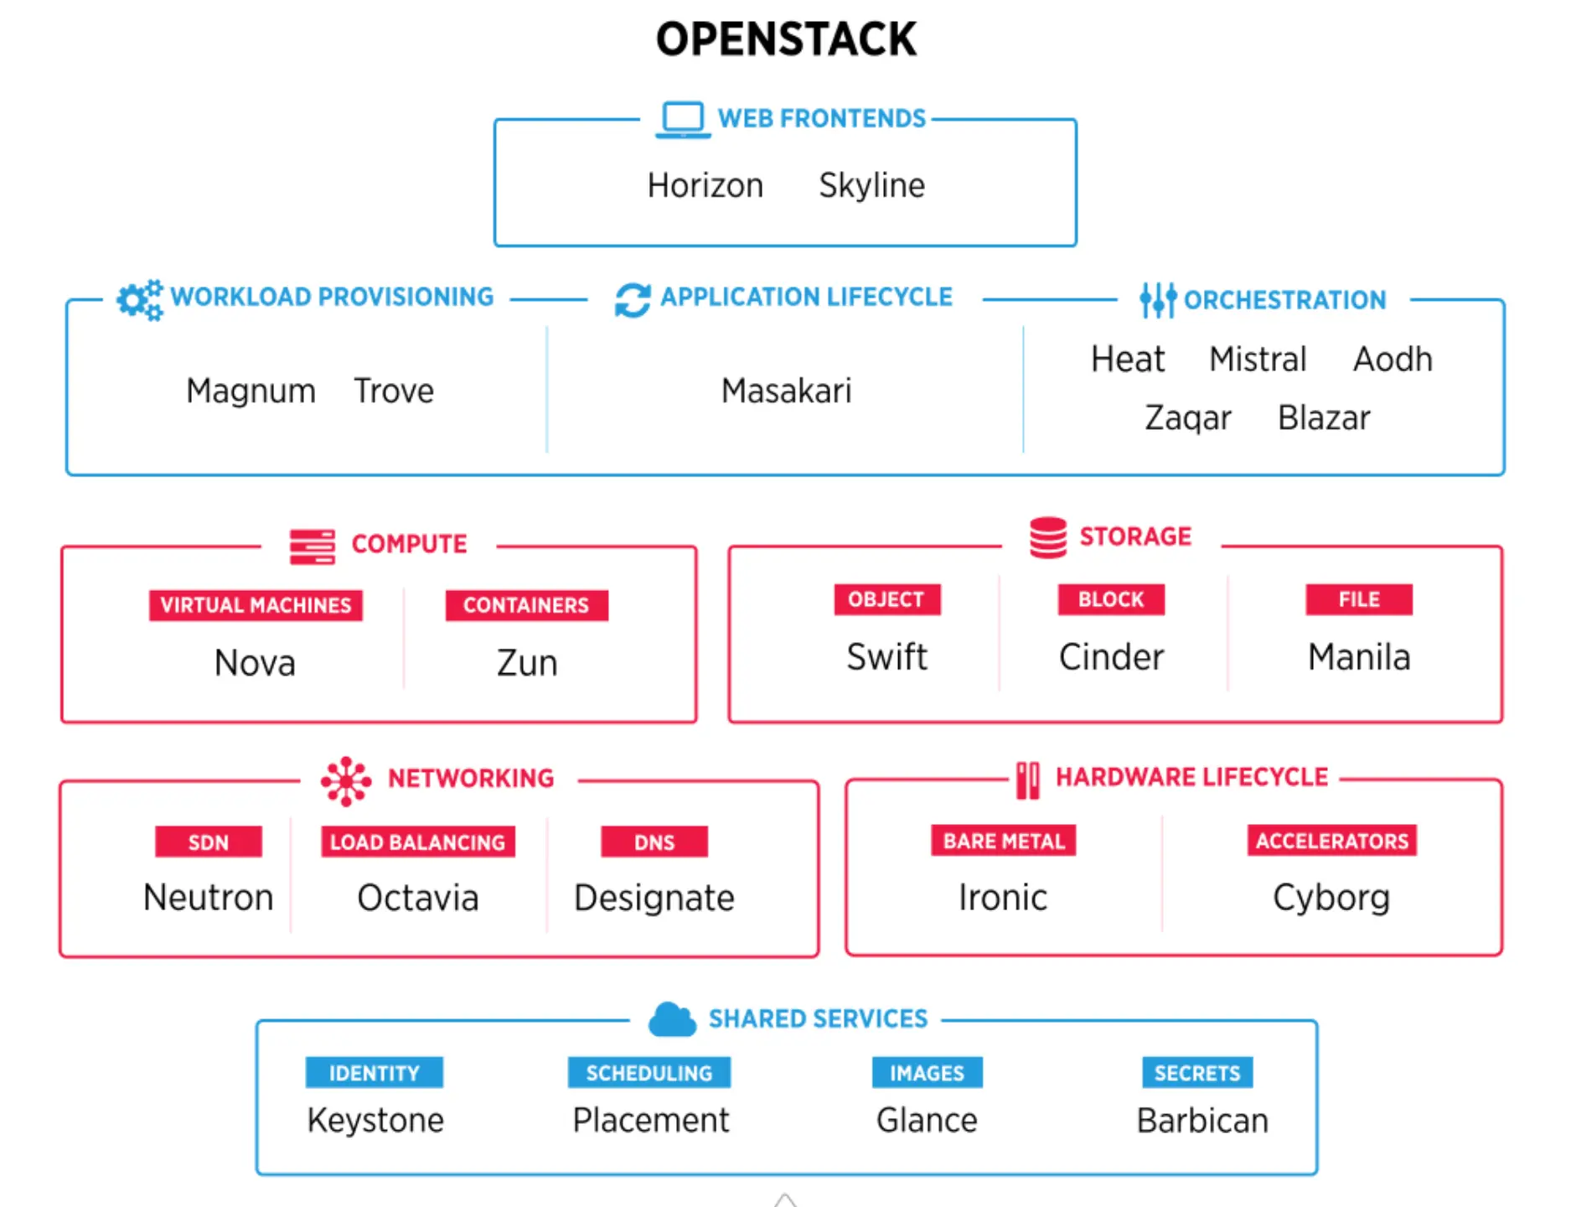
OpenStack
OpenStack is an open source project started in 2009 at NASA in collaboration with Rackspace (http://www.rackspace.com)
Though recently NASA has moved its cloud infrastructure to AWS, in addition to Rackspace, several other companies including HP, Cisco, IBM, and Red Hat have an interest in OpenStack.
The current version of the system supports a wide range of features such as: APIs with rate limiting and authentication, live VM management to run, reboot, suspend, and terminate instances, role-based access control, and the ability to allocate, track, and limit resource utilization.
The administrators and the users control their resources using an extensible web application called the Dashboard

Slide 23
Virtualization software
Notes:
Several virtualization software packages, including hypervisors, OS-level virtualization software, and desktop virtualization software, are available.
There are two types of hypervisors, native and hosted.

Slide 24

Native Hypervisors
You know what else is important?
A type 1 hypervisor, also referred to as a native or bare metal hypervisor, runs directly on the host's hardware to manage guest operating systems
Red Hat Virtualization (RHV)—enterprise virtualization based on KVM hypervisor.
Hyper—creates VMs on x86-64 systems running Windows.
z/VM—current version of IBM's VM operating systems.
VMware ESXi—enterprise-class, type-1 hypervisor from VMware.
Oracle VM Server for x86—server virtualization from Oracle Corporation. Incorporates the free, open-source Xen. Supports Windows, Linux, and Solaris guests.
Adeos—Adaptive Domain Environment for Operating Systems is a nanokernel hardware abstraction layer.
XtratuM—bare-metal hypervisor for embedded real-time systems. Available for the instruction sets x86, ARM Cortex-R4F processors, and others.
This Photo by Unknown Author is licensed under CC BY-SA-NC

Slide 25
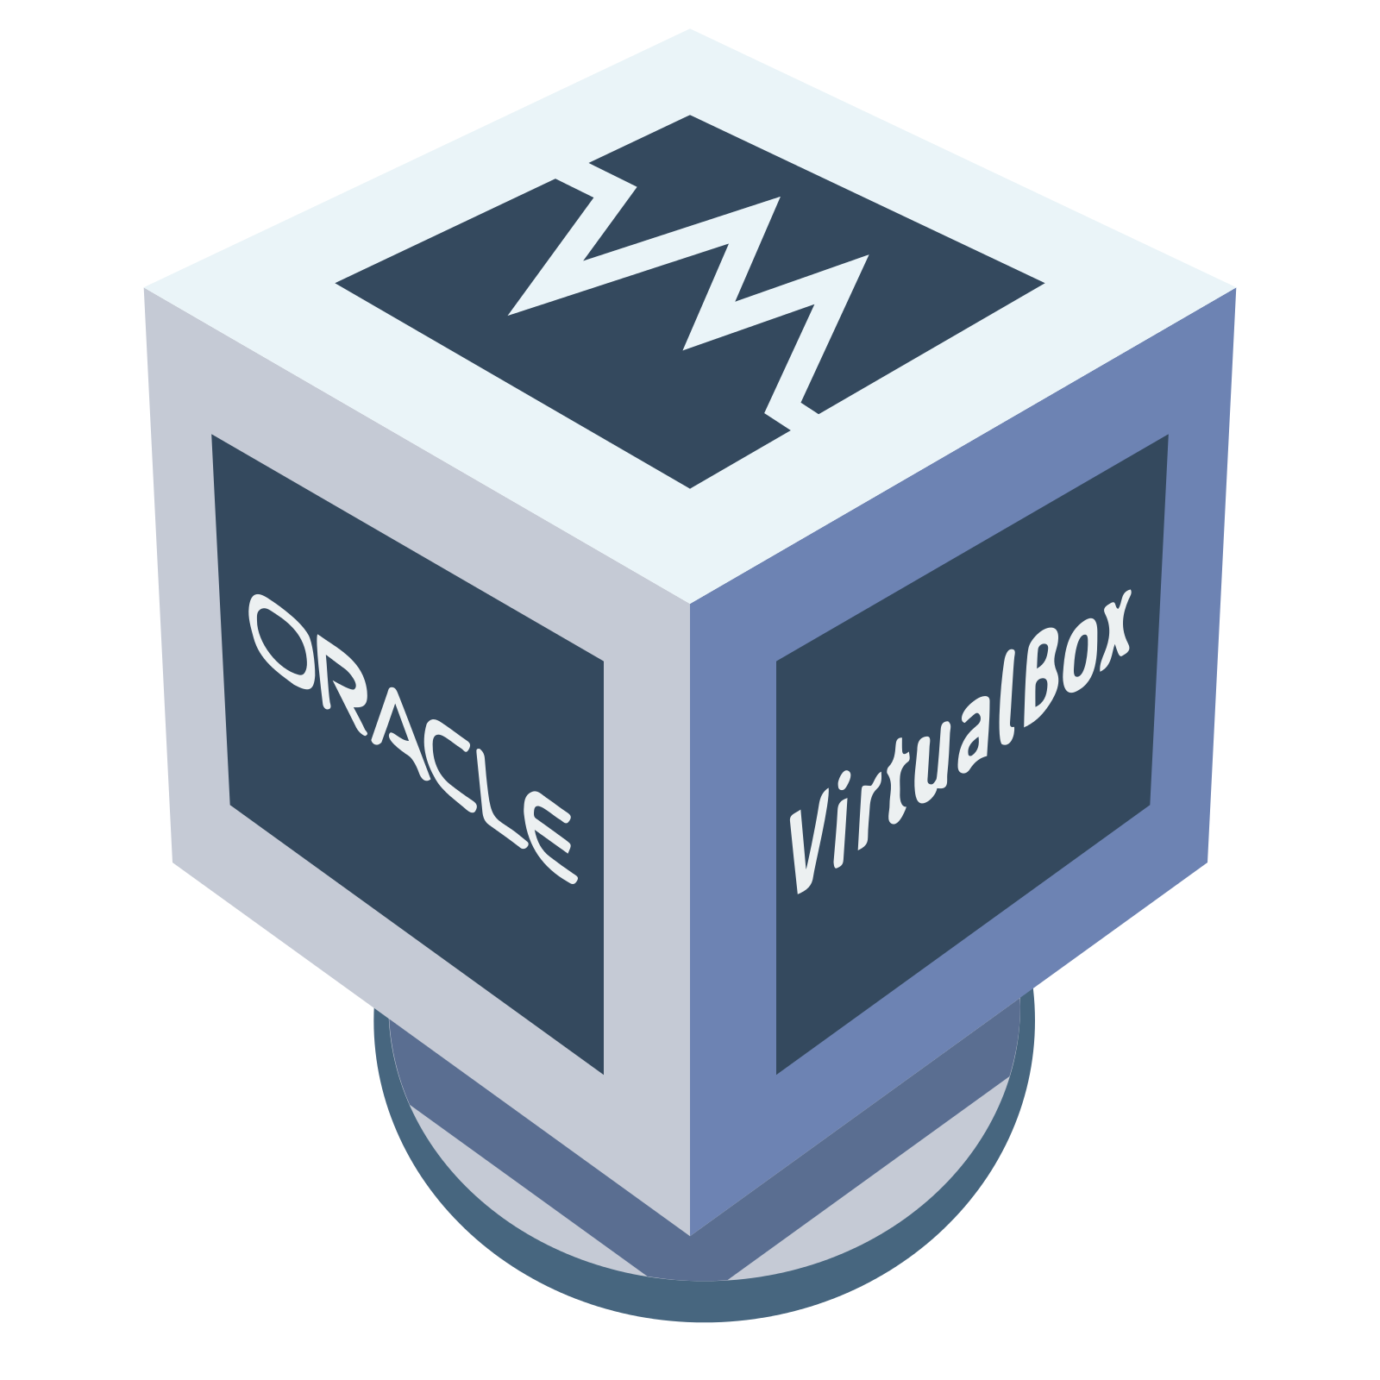
Hosted Independent Hypervisors
While bare-metal hypervisors run directly on the computing hardware, hosted hypervisors run on top of the operating system (OS) of the host machine.
VMware Fusion—software hypervisor developed for “Intel-based Macs to run Microsoft Windows, Linux, NetWare, or Solaris on VMs, along with the OS X OS, based on paravirtualization, hardware virtualization, and dynamic recompilation;
PearPC—architecture-independent PowerPC platform emulator for PowerPC operating systems, including pre-Intel versions of OS X, Darwin, and Linux;
Oracle VM VirtualBox—free and open-source hypervisor for x86 computers; and
QEMU (Quick Emulator)—free and open-source hosted hypervisor.
This Photo by Unknown Author is licensed under CC BY-NC

Slide 26
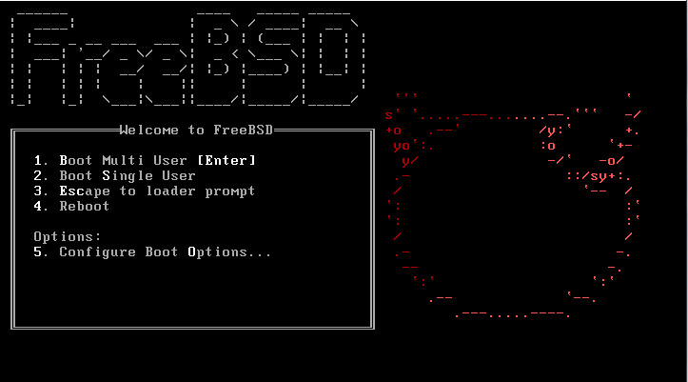
Hosted Specialized Hypervisors
There are factors that affects cloud availability, small mistakes could halt the entire operation.
coLinux—Cooperative Linux allows Microsoft Windows and the Linux kernel to run simultaneously;
MoM—Mac-on-Mac is a port of Mac-on-Linux for Mac OS X;
Mac-on-Linux—open-source VM for running the classic Mac OS or OS X on PowerPC computers running Linux;
bhyve—a type-1 hypervisor included in FreeBSD running FreeBSD 9+, OpenBSD, NetBSD, Linux and Windows desktop, and Windows Server; and
L4Linux—a variant of Linux kernel running virtualized on L4 microkernel; L4Linux kernel runs a service on L4
This Photo by Unknown Author is licensed under CC BY-SA

Slide 27

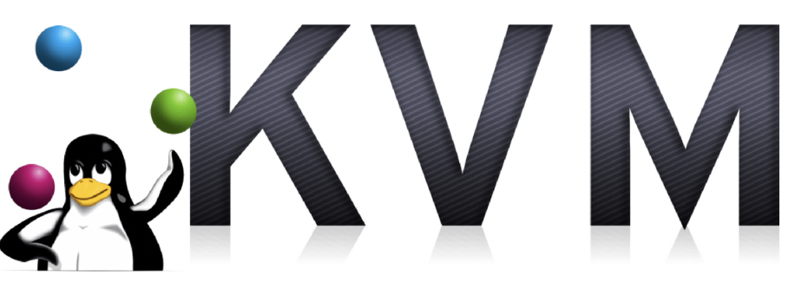
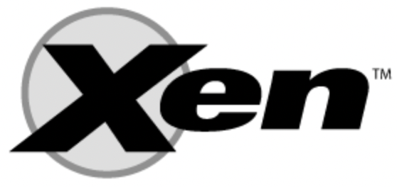
Virtualization implementation
Some implementation example
QEMU = Emulation + device virtualization (often paired with KVM).
KVM = Hardware-assisted virtualization integrated into Linux kernel.
Xen = Bare-metal hypervisor offering flexibility with full and paravirtualization.

Slide 28
Exercise
Students in the class make Groups
Each group pick one of virtualization implementation
In 30 minutes (estimate), each group present their discuss about cloud service provider (estimate each group have 5-10 minutes to presentation)
(Minimal content must included in discussion : Architecture, operating mode, components, performance)?

Slide 29
References
Marinescu, Dan C. (2022). Cloud Computing Theory and Practice: 3rd Edition. Morgan Kaufmann Publishers. ISBN: 978-0-323-85277-7
KVM - https://www.linux-kvm.org/page/Main_Page

Slide 30
Thankyou

